Slide 1

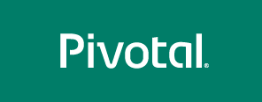
The Cloud Native Applications Journey
Notes:
test
afdas

Slide 2
Legacy Portfolio Realities
Things we hear:
Our portfolio is complicated, documentation is sparse and it’s a mix of many things
Architecture is often tightly coupled code and complex dependencies
Many people spend their days working with legacy technology; they lack new skills
What we believe:
Pivotal Cloud Foundry is the comprehensive Cloud Native platform to build the future
You get value by building apps on it
You see more value by moving existing apps

Slide 3
The Cloud Native Applications Journey
Microservices, Business Capability Teams, API First Design
CLOUD
NATIVE
MICROSERVICES
APPS REPLATFORMING
APPS MODERNIZATION
OPS & ORG TRANSFORMATION
RUNS ON LEGACY IT
RUNS ON PIVOTAL CLOUD FOUNDRY
RUNS WELL ON PIVOTAL CLOUD FOUNDRY
RUNS GREAT ON PIVOTAL CLOUD FOUNDRY
Your Existing Apps Running on Current-Era Stacks Supported by Time-Tested People and Process
Suitable Apps Moved to PCF with Minimal Code Change; Better Ops Thanks to Platform Automation
Legacy Apps Refactored Using 12-Factor Principles and Modern Software Process (TDD, CI/CD), Optimized for PCF
Cross-Functional Teams Delivering Continuous Software Updates Into PCF End-to-End Through Modern Principles

Slide 4
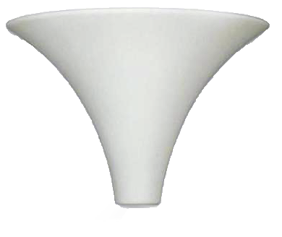

Choosing Candidate Apps
Licensing costs (HW / SW)
Time-to-market implications
Revenue impact-fullness
BUSINESS
ECONOMIC
TECHNICAL
Business criticality
Risk tolerance
Change frequency
Lifecycle stage
Domain expert availability
Codebase
Suitable framework / runtime
Relatively lightweight footprint
No “hard wire” file system dependencies
Usage / workload
Notes:
Apps above the value line

Slide 5
A Legacy Maturity Model
Cloud Native
Microservice Architecture and Principals
API First Design
Product capability teams, native microservices for both App + Data
Cloud Resilient
Use CI / CD tooling and methodology
Design for failure, Proactive testing for failure (TDD)
Apps unaffected by dependent service failure
Metrics and Monitoring baked-in
Cloud Agnostic runtime implementation
Adherence with all 12-Factor App principals*
Horizontally scalable
Leverage platform for HA
12-Factors + Advanced Platform Automation
Cloud Friendly
Cloud Ready
No file-system requirements or uses S3 API
Self contained app (Fat JAR)
Platform managed ports and addressing
Consume off platform services using platform semantics
4 to 7 of the Factors
* We believe there are more like 15 “factors” that exemplify a true, “Cloud Native” application… more later

Slide 6


How to start?

Slide 7
Traditional Ways of Tackling Modernization
PORTFOLIO
ANALYSIS
DESIGN
MIGRATION
TESTING
ACCEPTANCE
Lots of Upfront Study in a Multi-Phased Program
Uses Tools and/or Surveys to Gather Information
- Consultants who cast a wide net over everything
- Delivery of an expensive report and phased roadmap definition
Long projects with big budgets and large batches of work
- Failure is slow; it takes time and a lot of money to see problems
- Value is slow; measured returns often take years

Slide 8
Recommended Migration Path
Cloud Native
Microservice Architecture and Principals
API First Design
Work up from #2 to #4 at your own pace
Cloud Resilient
Use CI / CD tooling and methodology
Design for failure, Proactive testing for failure (TDD)
Apps unaffected by dependent service failure
Metrics and Monitoring baked-in
Cloud Agnostic runtime implementation
Cloud Friendly
Adherence with all 12-Factor App principals*
Horizontally scalable
Leverage platform for HA
Cloud Ready
No file-system requirements or uses S3 API
Self contained app (Fat JAR)
Platform managed ports and addressing
Consume off platform services using platform semantics
Start here

Slide 9
Getting to Cloud Native

Slide 10
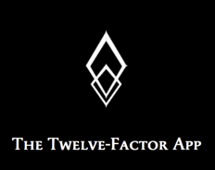
The 12-Factors
A “manifesto” of sorts published in 2012 by a team at Heroku
The goal of these 12-factors is to teach developers how to build cloud-ready applications using declarative formats for automating setup, had a clean contract with underlying operating system and were prepared for dynamic scaling
http://12factor.net/

Slide 11
VALUE, APPROACH
I. One Codebase, One App*
= Time to Market; find the seams; use good SDLC practices
II. Dependency Management*
= Dev Productivity; standardize & remove surprises
V. Build, Release, Run*
= Release Mgmt Hygiene; use CI/CD automation /w PCF
III. Configuration*
= Release Mgmt Hygiene; move to environment vars
XI. Logs*
= Real-Time Metrics; use PCF features; stdout / stderr
IX. Disposability
= Auto-Scale; move slow processes to backing services
IV. Backing Services
= Resiliency / Agility; use circuit breaker; loose binding
X. Environmental Parity*
= Reliability; use well architected PCF, get parity
XII. Administrative Process
= Reliability; move to backing service(s), expose as REST
VII. Port Binding*
= Ops Efficiency; use PCF features like routing, scaling, etc.
VI. Process
= Cloud Compatibility; move state to backing service(s)
VIII. Concurrency
= Auto-Scale, ZDD; design for cloud, use PCF features

Slide 12
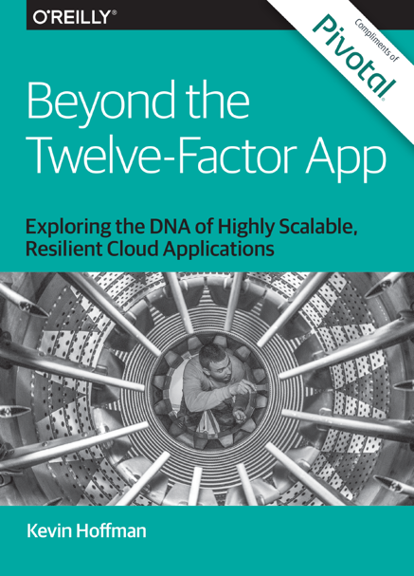
Looking Beyond 12-Factors
12-Factor App Was Published in 2012
In context of Heroku
A LOT has changed
This Book Provides New Guidance
With emphasis on Enterprise Java & PCF
Adds 3 new “factors”
API First
Telemetry – APM, Logs, Domain-Specific
Authn / Authz – Security First Design
A Must Read for Cloud App Architects

Slide 13
The road to microservices

Slide 14
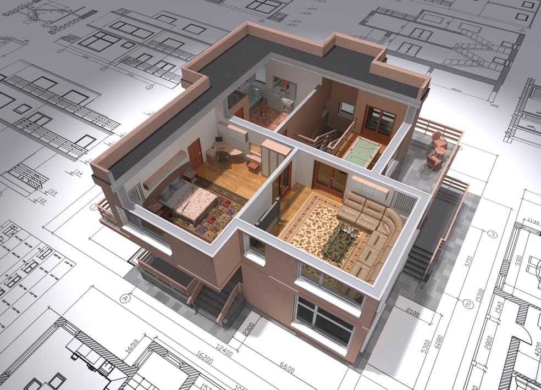
Breaking the Monolith – Picking Seams
Stability and Point of Evolution
Inbound and Outbound Coupling
Tools - Xray, JDepend, Structure101
Databases & Data Stores
Transaction Boundaries
Modes of Communication
Team Organization and Structure
Use Cases/User Journeys
Business Processes
Verbs & Operations
Nouns & Resources
Separated models for reading and writing

Slide 15
Monolith Decomposition
Patterns

Slide 16
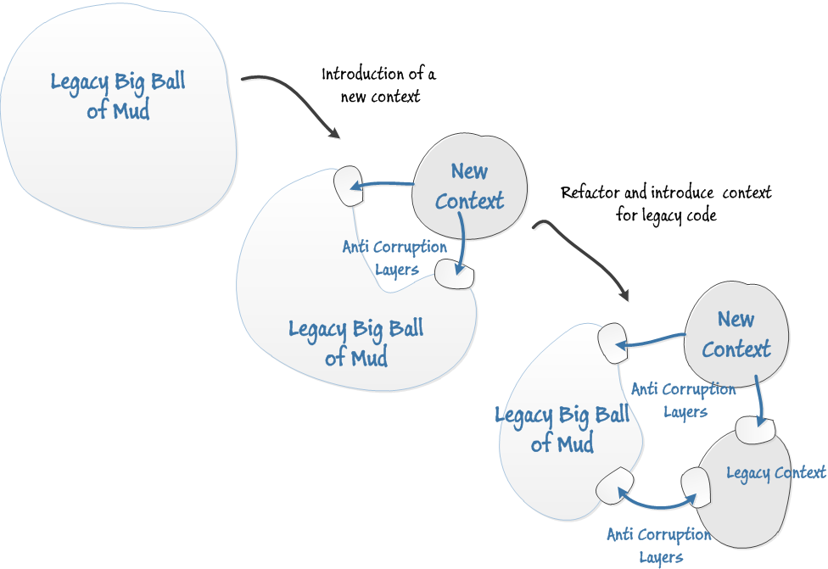
Anti-Corruption Layer
https://leanpub.com/Practicinga-DDD

Slide 17
STRANGLING THE MONOLITH
Step 1 and 2
Step 3 and 4
Consumer
Consumer
Consumer
Consumer
Abstraction
layer
Abstraction
layer
Component to
be replaced
Old version of
component
New version of
component
17

Slide 18

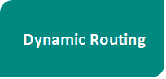
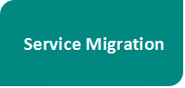
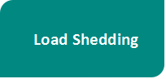
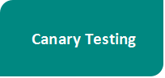
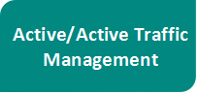
Smart Routing

Slide 19
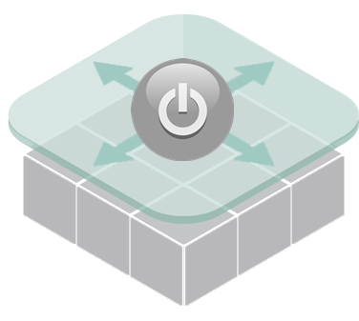

Dark Launching/Feature Flags
Wrapping software features in a way that let you turn them on or off
Why?
Private beta release
Commit your code in logical chunks
Release a new feature to all your users at a specific date
Not confident in how stable or how scalable a new feature is
How?
Boolean – Feature will be on or off
Percentage – Certain % of Users, Cookie, Random, Group
List – User ID, Group ID, Organization ID, …
Identity – Always on! and cannot be turned off.
Nil - Always off! and cannot be turned on.
Cloud Foundry Constructs
cf scale, Configuration Server, Route Services

Slide 20

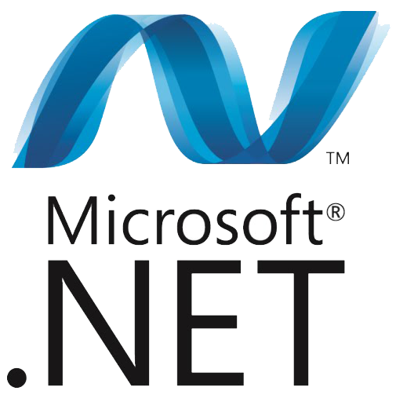

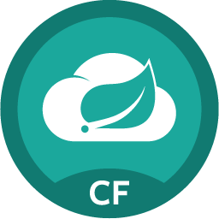
Distributed Systems are Hard!
Pivotal has got you covered!
Spring Cloud Services
for PCF

Slide 21


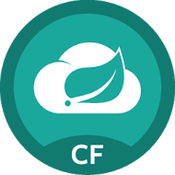
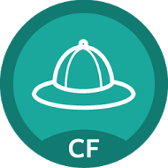
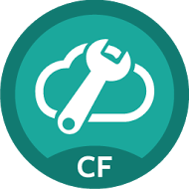

Application Framework Steeltoe
Steeltoe is a framework providing best practices for microservices in the .NET ecosystem
cross microservice configuration using Spring Cloud Config Server
service discovery provided by Eureka
circuit breaker behavior
Cloud
Services
Service
Registry
Config
Server
Circuit
Breaker
http://steeltoe.io

Slide 22
Application Framework Steeltoe
Steeltoe works...
with different versions of .NET framework and with .NET core
on Windows and on Linux
standalone and running on Cloud Foundry
Cloud
Services
Service
Registry
Config
Server
Circuit
Breaker
http://steeltoe.io

Slide 23
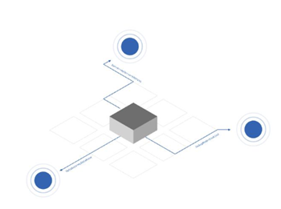
Configuration Providers
Config Server
- Access config stored in
Spring Cloud Config Server
- Across all instances, all apps, all environments

Slide 24
About Spring Cloud Config Server
2. Source
config
Git
Repository
Config Server
1. Push config
3. Pull
config
App A
App B
App C

Slide 25
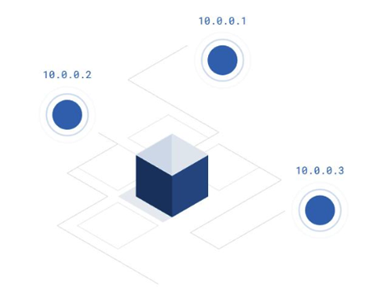
Service Discovery
Service Discovery Client
- .NET client for Netflix Eureka
Implements Service Discovery design
pattern
- Dynamically discover and call
registered services

Slide 26
About Eureka Server
Service
Registry
1. register
2. discover
Producer
Consumer
3. connect

Slide 27

Circuit Breaker
Circuit Breaker Client
- .NET implementation of Netflix Hystrix
- Bypass failing services with elegant fall-back behavior (so your users don’t see nasty error messages)
- Rich metrics and monitoring
- Available in Steeltoe 1.1

Slide 28

What We Believe
You Should Move Apps to PCF ☺
Plan Just Enough to Start
Start With “One Thing”
Break Big Things into Small Things
Automate Everything You Can
Leverage Cloud Native Framework
Let Real Work Form Strategy

Slide 29
Cloud Native Maturity Model
Cloud Native
Microservices architecture
API-first design
Fault-tolerant and resilient design
Cloud-agnostic runtime implementation
Bundled metrics and monitoring
Proactive failure testing
Cloud Resilient
Cloud Friendly
12 Factor App methodology
Horizontally scalable
Leverages platform for high availability
Cloud Ready
No permanent disk access
Self-contained application
Platform-managed ports and networking
Consumes platform-managed backing services
Notes:
Cloud Ready: No mounting file systems!
Cloud Friendly: Scalable, platform provides HA
Cloud Resilient: Cloud Agnostic, Fault Tolerant
Cloud Native: microservices + API first

Slide 30

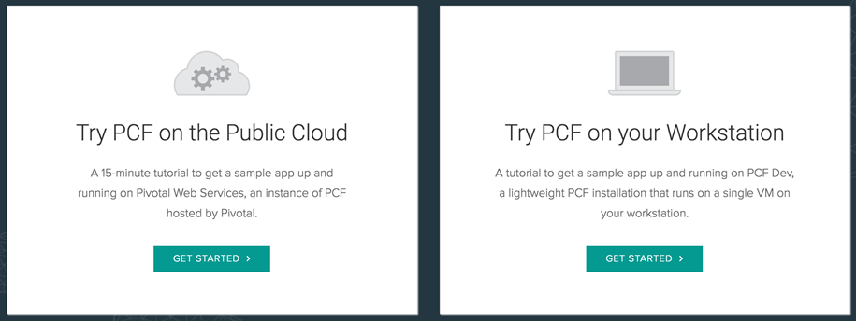
Getting Started with Pivotal Cloud Foundry
Try Pivotal Cloud Foundry by deploying a sample app within a matter of minutes

Slide 31
Simplified Journeys to Cloud Native Agility
“GREENFIELD”
CLOUD NATIVE APP DEVELOPMENT
NEW BUSINESS INITIATIVE
PIVOTAL LABS ENGAGEMENT
BACKING SERVICES / DATA ENGINEERING
(APPS REWRITE)
OPS & ORG TRANSFORMATION
RUNS GREAT ON PIVOTAL CLOUD FOUNDRY
APPS REPLATFORMING
APPS MODERNIZATION
RUNS ON LEGACY IT
RUNS ON PIVOTAL CLOUD FOUNDRY
RUNS WELL ON PIVOTAL CLOUD FOUNDRY
“BROWNFIELD”

Slide 32
Moving Workload to the Cloud

Slide 33
Topics
Replatform Overview
Why replatforming is important
How we help customers migrate applications
What we do in an engagement

Slide 34

Many Existing Apps Will Run on PCF
But, Why? Why Migrate to Pivotal Cloud Foundry?
FREEDOM
To Run Your App on Any Cloud
AUTOMATION
To Lower Your Ops Cost and Increase Your Velocity
RESILIENCY
Auto-Scale, Blue/green Deployments and Health Mgmt.
GOVERNANCE
Common Set of Developer-Self-Serviced Frameworks
VISIBILITY
End to End Logging, Monitoring and Auditability
SPEED
Move Cycle Time from Months to Weeks to Days or Hours
Notes:
Freedom – PCF abstracts underlying infrastructure and allows you to run workloads on PCF on any cloud with 100% confidence
Automation – lots here from platform to OS patching to zero downtime application updates
Resiliency – often this is what matters most; reducing the impact of having to roll back code and scaling out within seconds of workload spikes to health management
Governance – standardizing release management pipelines and self-service driven developer tooling
Visibility – all of your logs are passed into a time-sequenced stream … and typically integrated into Splunk and tools like Appdynamics
Speed – the ability to move cycle time on updates, for example, from months to weeks or days is Huge
All of these things have tangible, measurable impact… and often drastically improve current state realities

Slide 35

Evaluating the enterprise app portfolio
Licensing costs (HW / SW)
Time-to-market implications
Revenue impact-fullness
BUSINESS
ECONOMIC
TECHNICAL
Business criticality
Risk tolerance
Change frequency
Lifecycle stage
Domain expert availability
Codebase
Suitable framework / runtime
Relatively lightweight footprint
No “hard wired” file system dependencies
Usage / workload

Slide 36
What We Believe
You Should Move Apps to PCF ☺
Plan Just Enough to Start
Start With “One Thing”
Break Big Things into Small Things
Automate Everything You Can
Build Skills by Pairing and Doing
Let Real Work Inform Strategy

Slide 37

Cloud Native Application Maturity Model
4. CLOUD NATIVE
Distributed, API and microservice architectures running on time-tested technology like PCF, Spring Boot and Spring Cloud Services.
All new apps built Cloud Native
3. CLOUD RESILIENT
A 12-factor app with full metrics and monitoring, running on PCF that includes backing data services, automated failure testing & elastic scale.
Incrementally modernize and gain additional benefits
2. CLOUD FRIENDLY
A Cloud aware app built using 12-factor principals that takes advantage of Cloud for scale and resiliency
Replatform existing apps to run on PCF
1. CLOUD READY
Generally an app 0 to 7 years old that uses tech supported by the CF ecosystem and built in a modern, service-oriented manner
Notes:
Originally defined by JPMC who have PCF running for 100s of developers and applications
This is a great tool to quickly rationalize and qualify a portfolio, and track progress over time.
All new apps should be built, grounds up using Cloud Native architectures and platforms like PCF.
Then from a bottom’s up … start by reviewing your existing apps. Find those that are 0 to 7 years old and use tech supported by the CF ecosystem. Replatform these to PCF… get them running with minimal code changes.
Once on PCF… over time …. and as investment becomes available … build new features in modern ways and as you do this spend time both clearing some technical debt and also adding more “horizontal” features that will break logic into backing services and get more leverage from things like elastic scale and modern frameworks like Spring Boot, Spring Cloud Services and so forth.

Slide 38
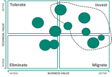


How to Start – What You’ll Need
A Rough Idea of Migration Candidates
ORGANIZATIONAL COMMITMENT
A motivated business unit with leadership committed to Cloud and a willingness to invest time and money in transformation.
LIST OF APPLICATION CANDIDATES
MOTIVATED
BU
Start with apps built <7 years ago using tech supported by PCF (ex. JEE) that are actively being used, updated and maintained
App Developers with Domain Knowledge
An Empowered PCF Ops Team with Ties to BU’s
GOOD PEOPLE
YOUR PCF PRODUCT
TEAM
A small team of people that understand candidate applications and made available to work on the initiative in a dedicated way

Slide 39
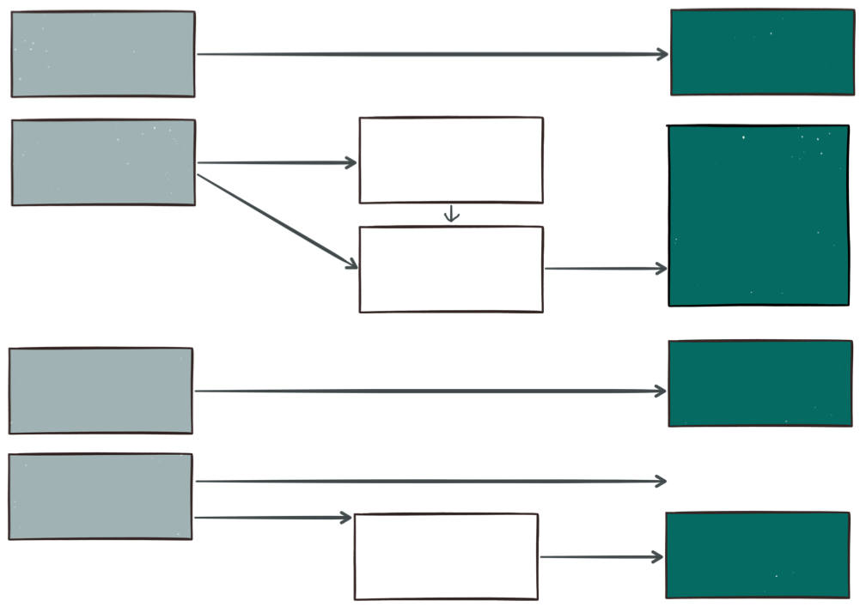
Chart the Transformation Path
JAVA
(BUILDPACK)
SPRING
FULL PROFILE
JEE
3rd PARTY
(BUILDPACKS)
MODERNIZE
WEB PROFILE
TYPE OF APPLICATION
BUILDPACK OR PCF 1.6+ FEATURE
.NET
(DIEGO CELL)
.NET
NODE.JS
PHP
GO … AND MORE
OTHER…
DOCKER
DIEGO
(GARDEN LINUX)
Notes:
Buildpacks provide framework and runtime support for your applications. Buildpacks typically examine user-provided artifacts to determine what dependencies to download and how to configure applications to communicate with bound services.

Slide 40
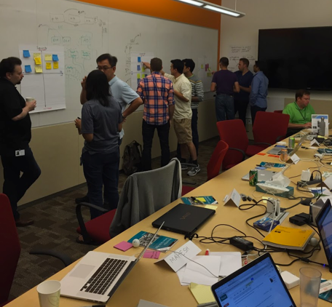
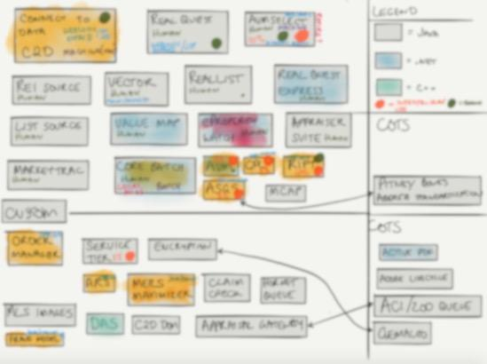
How to Start – What To Do
Don’t Plan Everything; Start Small and Let Your Work Inform the Strategy
Scope
Prepare your initial list of apps
Get the right people in a room
Define the business value to drive
Snap Analysis
Look at suitability
Decide on migration flows
Flag risks and assumptions
Begin With a Time-Bound Pilot
Designate the right people
Work for 6 to 10 weeks on a backlog
Translate work done into patterns cookbook

Slide 41

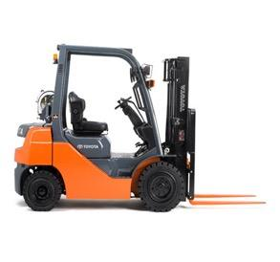

Replatform and Modernize
APPLICATION REPLATFORMING
APPLICATION MODERNIZATION
APP
µService
APP
APP
APP
APP
µService
APP
APP
APP
µService
The “Push” Approach
The “Pull” Approach
Push the app
See what fails
Write a test
Get the tests to pass
Write down your recipes
Build new features as microservices
Find the seams
Write tests
Refactor code around seams
Get your tests to pass

Slide 42
Replatforming Existing Apps
Work with One Business Unit; Target 7 to 10 Apps in 10 Weeks
Discovery & Framing
Suitability Workshops; Technology Planning
Backlog Development, Grooming & Prioritization
Platform Extensibility
Buildpack Engineering; Apps Configuration
Test Automation
Build CI/CD Pipelines; Automate Testing for App & Backing Services (e.g. Connectivity, Perf.)
Refactoring
Backing Service Location / Configuration
File System Usage, Messaging, etc.
Process and Documentation
CI Everything (Including Docs)
Reference Patterns Informed by Work
REVIEW
MODIFY
TEST
TYPICAL ACTIVITIES
PRODUCTION PCF APPS
PATTERNS & SAMPLES

Slide 43
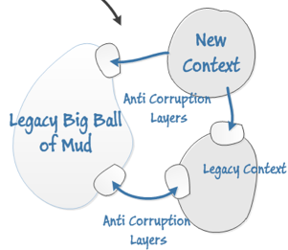
Modernize and Tackle Complexity Next
Decomposing the Monolith
TOPS-DOWN
Ideally, Take a Tops-Down Approach
Find a Modest Sized Business Feature
Use a Small Team to Work on the New
Domain Experts Paired with People Who’ve Done This
Identify the Legacy Seams and New Context
Build Code in Modern Ways (TDD, µServices, etc.)
Create Anti-Corruption Layer for Translation
Data Decomposition Can be Tricky
Build Some Horizontal Features as You Go
Parallel Production as Parts Come Online
Use the Work to Inform Next Efforts
Take a legacy, customer-facing component and make it a first class experience. Incrementally modernize parts of the legacy app while you do this.
Tackle the technical debt; decompose the app, incrementally make improvements and evolve into a “cloud first” state
BOTTOMS-UP
Notes:
Bottoms-up: decompose the monolith, incrementally make improvements and evolve the app into a "cloud first" state
Tops-down: take a customer-facing component and make it a first-class experience; as you do this, make architectural improvements that can be used commonly across the platform
Monolith – all data in one place ---- a common mistake is to leave the data as-is and then u get a distributed ‘ball of mud’
THD…
In the meantime, how do we continue to deliver business value? The approach here is to work on business stories (as opposed to pure refactoring stories) and migrate those pieces of code out of the Grid application that are touched. What this means is that there will be a significant time for which the "app" will exist in both places (Grid and PCF). I think we will still be able to deliver business value incrementally and faster with better quality than before. But this needs to be measured to ensure it is happening.

Slide 44
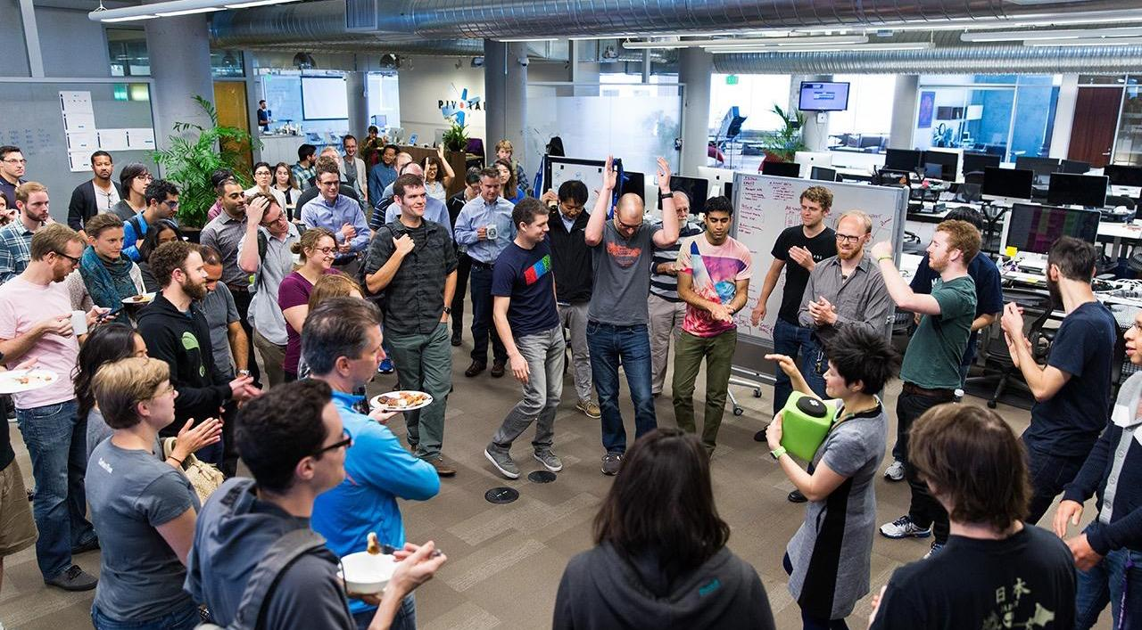
Case Studies
160 Year Old Insurance Company
The Home Depot
Comcast

Slide 45
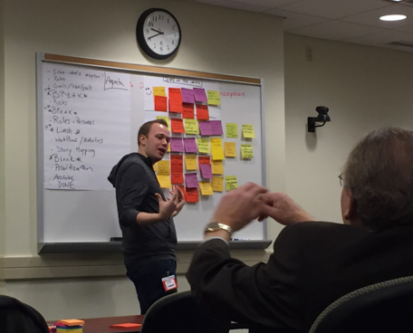
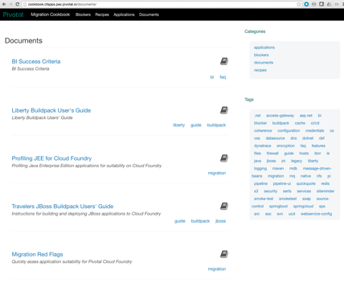
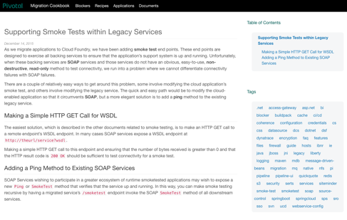
Large Insurance Group
Ten Weeks, Building Blocks and Seven Apps
A ten week project to re-platform as many apps as possible while building components and patterns to expedite future work
A Team of 4 Developer Pairs
Workshop-Led Suitability Planning
Test-Driven Deployment
7 Apps Production-Ready in 10 Weeks
Cookbook and Recipe PCF Site
Legacy Integration Building Blocks
Acceleration of Subsequent Migrations
2wks for 2 JBOSS Apps to Spring Boot
Notes:
Building Blocks
Liberty Buildpack – OOB supports JEE 6 and 7; enhanced to support Dynatrace APM, custom binaries for app servers and JVM settings and siteminder integration
JBOSS Buildpack – enhanced to allow developers to use config injection; automates creation of legacy standalone.xml file based on what’s configured via CUPS (JDBC binding, WebServices, arbitrary env vars, MQ series connections, siteminder, JMS, JBOSS log levels) and accomodates customer-specific JNDI conventions

Slide 46
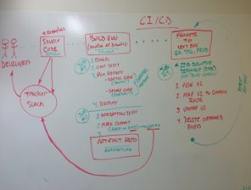
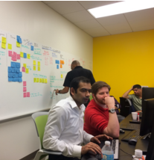
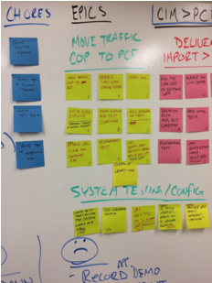
The Home Depot
Five Weeks, Five Services, High Fives
A ten week project to modernize an Invoice Management Platform into Spring microservices running on PCF
A Team of 4 Pairs
Working in Dedicated Space @ THD
Using TDD and CI/CD from Day One
Delivered 5 Services in 5 Weeks
2 Running in Production
Additional 3 in Next 5 Weeks
And Spikes to Determine Data Approach
Watch One > Do One > Teach One

Slide 47
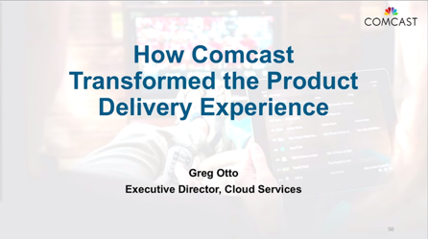
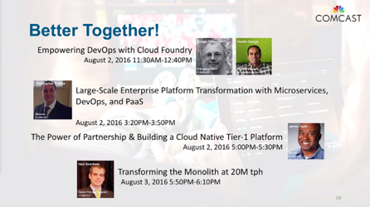
Comcast
A People, Process and Applications Journey
Transforming the hearts and minds of 1000+ developers as we modernized code and enabled new platforms and practices
Started with a 2 Day POC Workshop in 2014
Working Prototype App in 30 Days
Operational Enablement in 3 Months
Transformation of ESP
500+ servers and 100s of services
ESP now running on PCF (1 Year Project)
75% Faster Time-To-Market
Zero downtime maintenance
Drastically faster turnaround
Transformative Journey Continues
SpringOne Platform YouTube Channel

Slide 48
Ex: Large Bank Asset Management Application Portfolio
Out of the 76 Websphere applications that will be migrated. Focus here and start with the first 10 most impactful apps to Company X
Tolerate
Invest
BETTER
TECHNICAL VALUE
Realize Immediate ROI Through:
Auto-Scaling
Automated Health Management
Zero Downtime Updates
Reduce Proprietary License Spend
WORSE
Eliminate
Migrate
WORSE
BUSINESS VALUE
BETTER
* Gartner’s TIME methodology for Application Portfolio Rationalization

Slide 49


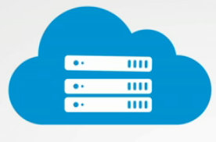
Cost saving on custom developed legacy apps
Platform Ops
Platform Dev
IaaS Utilization
90%
50%
20%
Notes:
Increase IT Operations Productivity by 90%
Operators now provide application dial tone, instead of bogged down in never ending manual complexity and fire-drills
Before PCF
Establish infrastructure
Configure environments
Install middleware
Months to support a new language or framework
Maintain gold image across environments
Apply Patches
Capacity management
Policy and Authentication
Write and manage automation scripts. Highly error prone
After PCF
Single pane of glass
Self-managed & self-regulated
Most functions are automated
Cloud Deployment: 2-4 hours
Increase Server to Admin ratio
Increase Developer Productivity by 50%
Developers dramatically increase speed of app deployment
Before PCF (non-dev work)
Provision VMs
Install OS, Middleware
App Server set up
Manage versions across dev/test/stage/production
Scale App
Error prone
Open IT helpdesk tickets
Wait for resolution
After PCF
Auto-select runtimes
Select and bind middleware
Deploy app
Scale App
Steps above: 2 minutes

Slide 50

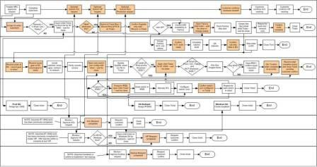
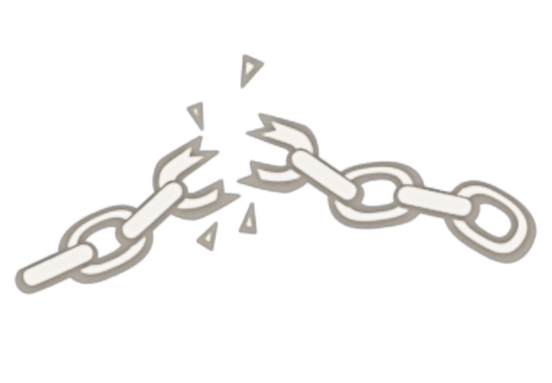

Monolithic Applications Drive Complex, Manual Deploys & Waterfall Release Cycles
Developer
Can you deliver full CI/CD for every major app in your portfolio today, or are you doing 75+ step manual deployments?
Operator
Notes:
We’re working with customers like Comcast and Lockheed Martin who have been struggling to ship software faster. Both in terms of new projects and implementing these modern, DevOps-friendly environments that can handle real continuous delivery.
If you’re doing big project with ‘agile waterfall’ where you use agile development with weekly sprints but have a huge manual process to actually ship every 3-9months.
Disconnect between dev and ops. Throw the code over the wall
… and do it all over again from Dev → Test → Prod on any infrastructure

Slide 51

We believe that monoliths used to be an appropriate early stage choice, but outlive their design in the later stages of the application’s adoption lifecycle.

Slide 52
Why Migrate Monoliths to PCF?
BENEFITS
BENEFITS
Cloud Portability – free to run on any Cloud
Significant operational efficiencies
Auto-scaling; efficiencies for spikey workloads
Automate patching, upgrading, and lifecycle management
Constant innovation of platform capabilities
Management and monitoring through the platform
Standardize on dev stacks and platform-provided services
Runtime consolidation

Slide 53

Tools – SchemaSpy – graphical relationship viewer
Tools - Liquibase, Flyway, jooQ to Auto apply bundles of database refactorings
Require a transition period during which both the original and new schemas exist in production
Expose a Facade service to encapsulate DB changes
Move logic and constraints to the edge aka services
Implement retry and compensations
Database Transformation Patterns cataloged in “Refactoring Databases” seminal book by by Scott J Ambler and Pramod J. Sadalage
Migrating
Data

Slide 54
ESB to Microservices
DECENTRALIZATION
BENEFITS
Follow a phased approach to migrating ESB composite and provider services
Business logic should reside in Java apps and only fundamental ESB functions like legacy adapters and pure transformation and mediation should be handled by the ESB
Where existing ESB services do not already exist, start greenfield net new development with a pure microservices based approach
5 Step Evolution of the ESB to the Cloud
1. Co-exist 2. Lift & Shift 3. Refactor 4. Replace 5. Transform

Slide 55
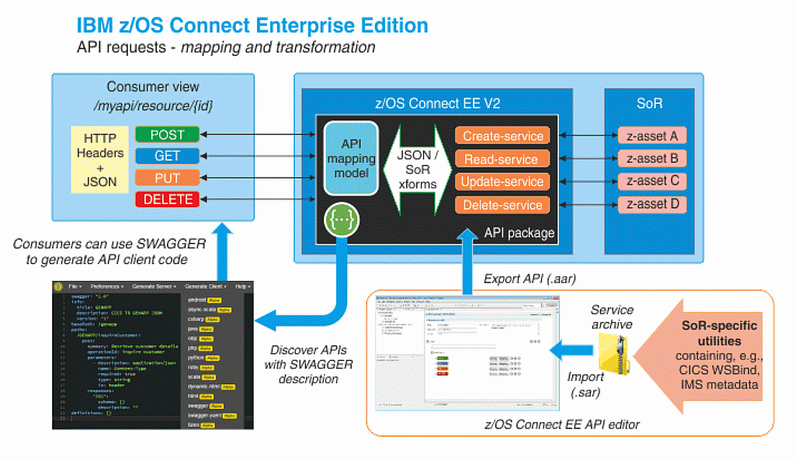
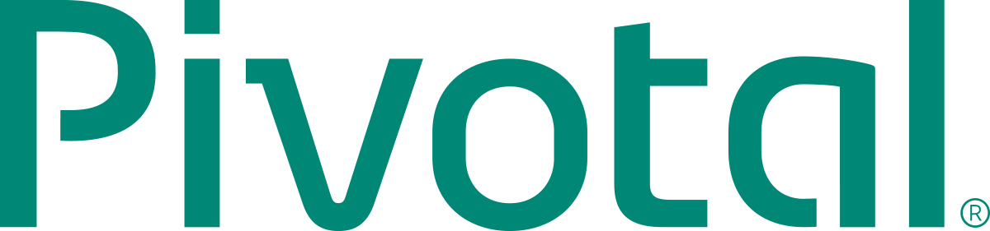
Modernizing Batch
Address Concurrent Batch and Online
z/OS v2 Connect
Eliminate needless Data Movement
Eliminate file transfer and unnecessary app integration
Scheduling and Job Management
Technical Solutions
Leverage Distributed Batch

Slide 56
A word about organization structure
Conway's Law asserts that organizations are constrained to produce application designs which are copies of their communication structures
Leads to unintended friction points.
Evolve your team and organizational structure to promote your desired architecture
Break down silos to foster collaboration
Your technology architecture is then isomorphic with your business architecture.

Slide 57
Refactoring Recipes

Slide 58
Application Level Eventual Consistency
Persist operation state in the client microservice and track to success or compensate
Databases SQL or NoSQL Gemfire
Queues ( RabbitMQ, JMS, WebSphereMQ, Tibco .. etc)
Spring State Machine
Java 8 Completeable Futures
“Distributed transactions in Spring, with and without XA” from Dave Syer
http://www.javaworld.com/article/2077963/open-source-tools/distributed-transactions-in-spring--with-and-without-xa.html

Slide 59
Monolithic Edge UI Gateway
Make a UI Microservice that is exposed to end users and have it serve up the UI?
Browser
Native Mobile
UI
A
B
C

Slide 60
Foreign Keys Constraints
How are Foreign Key Constraints Validated Across Table is Different Bounded Contexts
Enforcing Foreign Key Constraints between microservices becomes an application level problem to be handled by the microservices rather than the database
Usage of Immutable Stable URI’s to identify Foreign keys can be helpful

Slide 61
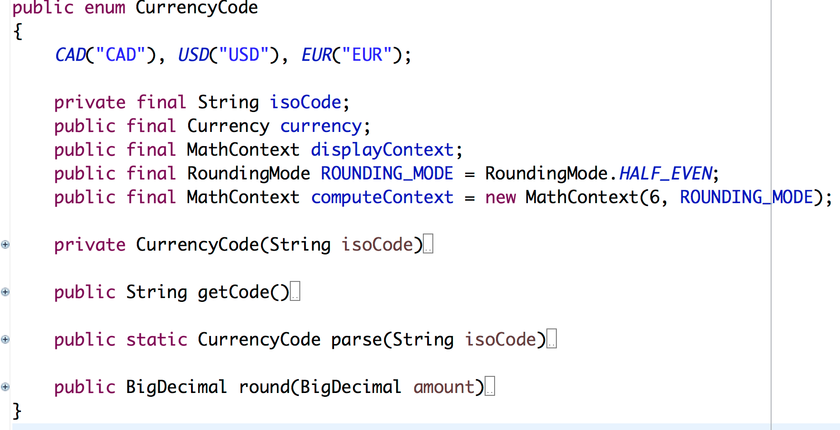
Shared Static Data Becomes Code
Turn Static Shared Data into Code Accessible via dependency manager

Slide 62
Back End For Front End
Extend each UI experience with a dedicated backend component for UI http://samnewman.io/patterns/architectural/bff/
Browser
Android Mobile
WEB BFF
Android BFF
A
B
C

Slide 63
Use JWT Tokens
Use JSON Web Token to pass user info between microservices
Microservice A
Microservice B
JWT
JSON Web Tokens are an open, industry standard RFC 7519 method for representing claims securely between two parties.

Slide 64
Distributed Systems are Hard!
Pivotal has got you covered!
Spring Cloud Services
for PCF

Slide 65

To Be Cloud Ready
Non Cloud-Native stuff you’ll want to change:
Reading/Writing to the Registry
Reading/Writing to the local disk
Integrated Windows Auth
In-Process State
Environment-specific config

Slide 66
Applications to exclude
Packaged or SaaS applications
Apps with tight coupling to hardware or legacy OS
Apps with no business reason to change frequently
Apps with tenuous connection to consumers or clear business value
Apps so trivial … no one will care
Apps so massive ... no one should dare

Slide 67
Evaluating Migration Suitability
WON’T RUN ON CLOUD
BENEFITS
Accepts inbound connections for non-HTTP protocol
Application Container Hosted Clustering
Relies on container-based clustering for resiliency and scale
Relies on container for shared state (see stateful process)
Stateful Process
Uses in-memory cache (in-process)
Could cause corruption or data loss if application was restarted without warning
Filesystem I/O (Reading files from disk; Writing files to disk; I/O with NFS mount)
Logging to any destination other than STDOUT or STDERR (console)
Use of distributed transactions of any kind, including XA
Extremely long application startup and shutdown time – those measured in minutes
Use of Java properties files/.NET web.config files
Use of hardcoded configuration – URLs, Credentials, Database connection information, Queues and Topics
Nonstandard security - App relies on a nonstandard security mechanism that conflicts with standardized Siteminder security in customized buildpacks
Batch Processing - Autosys or cron invoke shell or batch scripts to invoke ad hoc functionality

Slide 68


Start by Replatforming Suitable Applications
Work with One Group; Move “10s” of Apps in 10 Weeks
TYPICAL ACTIVITIES
BENEFITS
Discovery & Framing
Suitability Workshops; Technology Planning
Backlog Development, Grooming & Prioritization
Platform Extensibility
Buildpack Engineering; Apps Configuration
Test Automation
Build CI/CD Pipelines; Automate Testing for App & Backing Services (e.g. Connectivity, Perf.)
Refactoring
Backing Service Location / Configuration
File System Usage, Messaging, etc.
Process and Documentation
CI Everything (Including Docs)
Reference Patterns Informed by Work
REVIEW
MODIFY
TEST
PRODUCTION PCF APPS
PATTERNS & SAMPLES

Slide 69
Replatforming Java apps
JAVA
(BUILDPACK)
SPRING
FULL PROFILE
Java EE
3rd PARTY
(BUILDPACKS)
MODERNIZE
TYPE OF APPLICATION
WEB PROFILE
BUILDPACK OR PCF 1.6+ FEATURE
.NET
OTHER…
DOCKER
DIEGO
(GARDEN LINUX)

Slide 70
Replatforming to Spring Boot
Introduce Spring Boot Dependencies
Introduce Cloud Profile that can read configuration settings from VCAP_SERVICES
Application should be able to run on PCF and on standalone Tomcat
Modify the spring boot packaging to use executable jar/war
Profile Cleanup - A separate profile for every environment / easy and clean
Tune your CI / CD pipeline to take full advantage of Spring Boot

Slide 71
Replatforming .NET Applications
Console
Windows
Service
No
ASP.NET
ASP.NET
4.5+
yes
uses
GAC?
No
Diego
No
ASP.NET
MVC
MVC 3+
yes
uses
GAC
No
Sharepoint
Biztalk
Dynamics
etc...
NO
More Information: http://cloud.rohitkelapure.com/2016/06/replatforming-net-applications-to-cloud.html

Slide 72
Generic Bounded Context Refactoring Recipe
BOOT + HEX ARCHITECTURE
BENEFITS
Search for all the call sites into the bounded context
Analyze the current interfaces exposed by the bounded context
Define the required ports for the bounded context
Analyze external dependencies used by the bounded contexts
Define the required adapters for the bounded context
Analyze how the bounded context will stay in sync with the rest of the system
Define what domain events the bounded context will emit
Define what events the bounded context will listen for
Copy and paste the code from the old project s
Create a new spring boot project for hosting the refactored code
Add the newly configured project to the CI / CD Pipeline
Write unit and integration tests
Cut and paste code and refactor it
Iterate until done

Slide 73
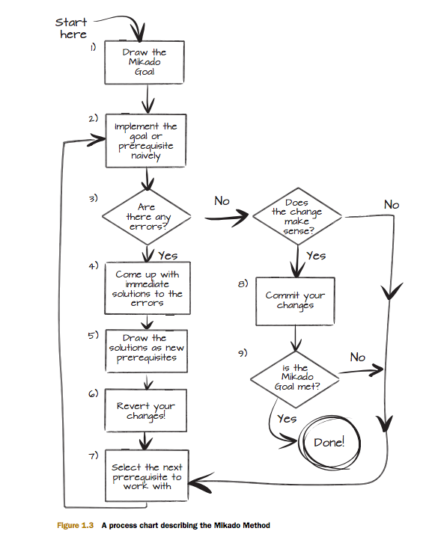
Mikado Method
https://www.manning.com/books/the-mikado-method

Slide 74
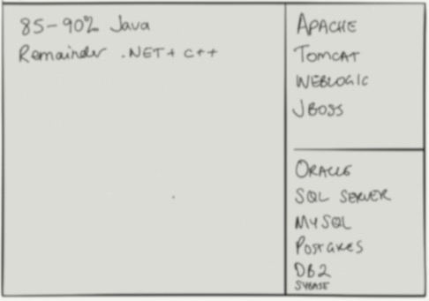

To begin
Don’t Plan Everything; Start Small and Let Your Work Inform the Strategy
SCOPE
DISCOVER &
FRAME
TIME BOUND
PILOT

